Slide 1
Employee Data Analysis using Excel
STUDENT NAME: SIVA PARVATHI V
REGISTER NO: 31223386(8C17441BCA60A8086E34EC3DA28EB571)
DEPARTMENT: BCOM COMMERCE
COLLEGE: PRINCE SHRI VENKATESHWARA ARTS AND SCIENCE COLLEGE

Slide 2
PROJECT TITLE
Employee Performance Analysis using Excel

Slide 3


AGENDA
Problem Statement
Project Overview
End Users
Our Solution and Proposition
Dataset Description
Modelling Approach
Results and Discussion
Conclusion
3/21/2024 Annual Review

Slide 4

PROBLEM STATEMENT
2. Collect and Analyze Data in Excel
3. Summarize Findings
4. Craft the Problem Statement
5. Create a Slide in PowerPoint
6. Review and Refine

Slide 5

PROJECT OVERVIEW
The project focuses on analyzing employee performance using Excel as the primary tool. It involves collecting and organizing performance data, including metrics such as productivity, efficiency, and key performance indicators (KPIs). Excel's advanced functions, like pivot tables, charts, and conditional formatting, will be used to visualize trends and identify areas of improvement. The analysis aims to provide insights into performance patterns, highlight top performers, and suggest actionable strategies for enhancing overall employee productivity and engagement. This project will culminate in a detailed report and a PowerPoint presentation summarizing the findings.
.

Slide 6
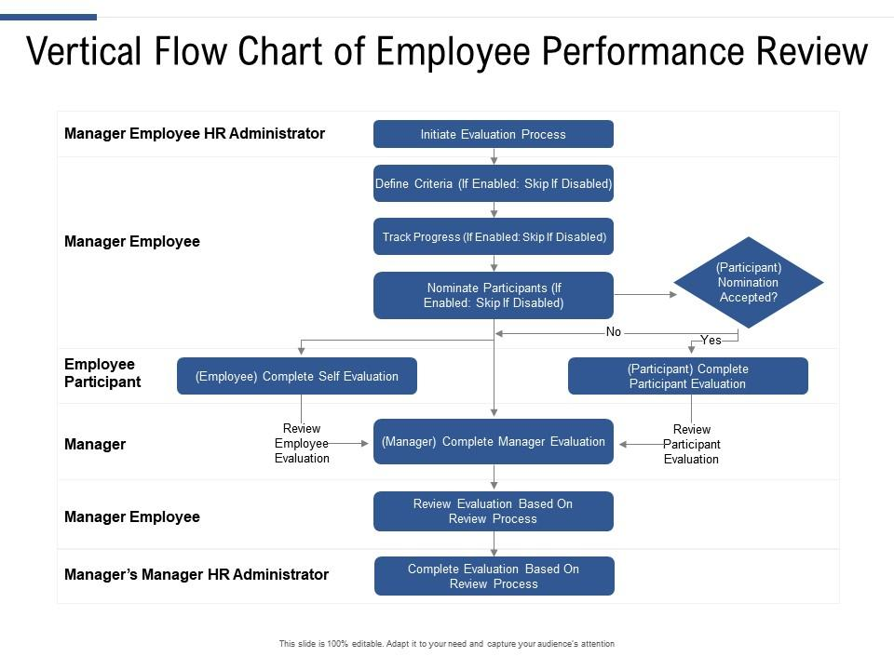

WHO ARE THE END USERS?

Slide 7

OUR SOLUTION AND ITS VALUE PROPOSITION
=IFS(Z8>=5,"VERY HIGH",Z8>=4,"HIGH",Z8>=3,"MED",TRUE,"LOW")

Slide 8
Dataset Description
Downloaded employee data set using -kaggle
Features used
Emp ID
Name
Gender
Business cycle
Performance score
Current performance rating
Performance level

Slide 9

THE "WOW" IN OUR SOLUTION
=IFS(Z8>=5,"VERY HIGH",Z8>=4,"HIGH",Z8>=3,"MED",TRUE,"LOW")
Pivot table,pie chart and bargraph Highlighting the features
3/21/2024 Annual Review
<number>

Slide 10
MODELLING
1.Dowloaded employee data sheet from
kaggle
2.selected 20 datasets in the downloaded data sheet and created a new data sheet
3.Highlighted the features used in the data sheet
4.select the employee performance and done the Eligibility status
5.create the pivot column and created pie chart and bar graph
6.Made analysis using the bargraph
<number>

Slide 11
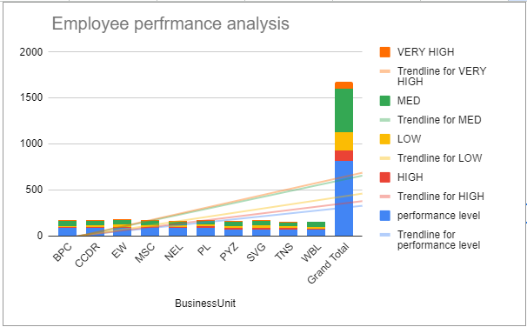
RESULT
<number>

Slide 12
conclusion
This project successfully leveraged Excel to analyze and visualize employee performance data, providing a comprehensive overview of productivity and efficiency across the organization. Key insights include identifying top performers, pinpointing areas where improvement is needed, and recognizing trends that may impact future performance. The use of Excel's advanced features enabled a detailed, data-driven assessment that supports strategic decision-making. Moving forward, the organization can utilize these findings to implement targeted development programs, optimize resource allocation, and enhance overall employee engagement and productivity. Regular monitoring and updates to the Excel model will ensure continued alignment with organizational goals.

